Slide 1
DDI-RDF Discovery Vocabulary _ Use Cases and Vocabularies
5th European DDI User Conference
04 December 2013, Paris, France
Thomas Bosch
GESIS – Leibniz Institute for the Social Sciences, Germany
thomas.bosch@gesis.org
boschthomas.blogspot.com
Notes:
Outline
-----
What is RDF validation?
DB URL
Idea of DB / sources
From case studies via use cases to requirements and requirements coverage (From a Case Study to a Solution (and Back))
Requirements classification
Present different requirements which are validated using constraints
How to formulate constraints
No one-size-fits-all solution
using different solutions covering different requirements
How to contribute? [Live demo]
DC case studies, use cases, and requirements (e.g. DM2E)
Requirements classification

Slide 3
From a Case Study to a Solution (and Back)
Case Study: DM2E
Use Cases:

Slide 4
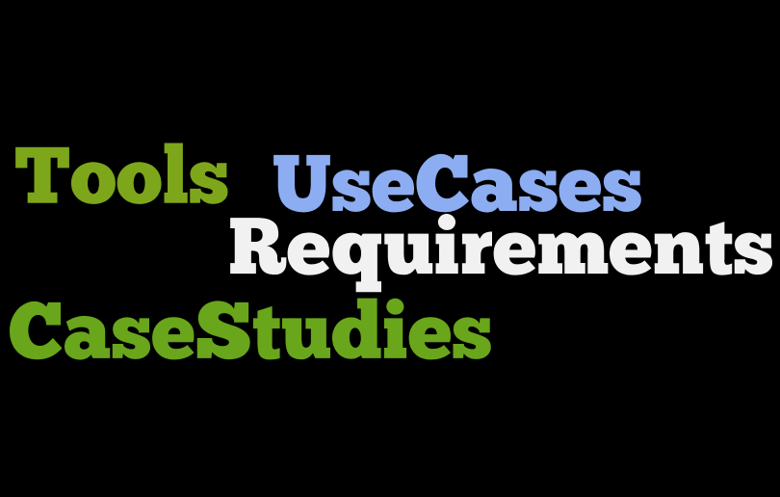

Slide 5
From Case Studies does exist according to specific metadata?

Slide 6
Which microdata does exist according to specific metadata?

Slide 7
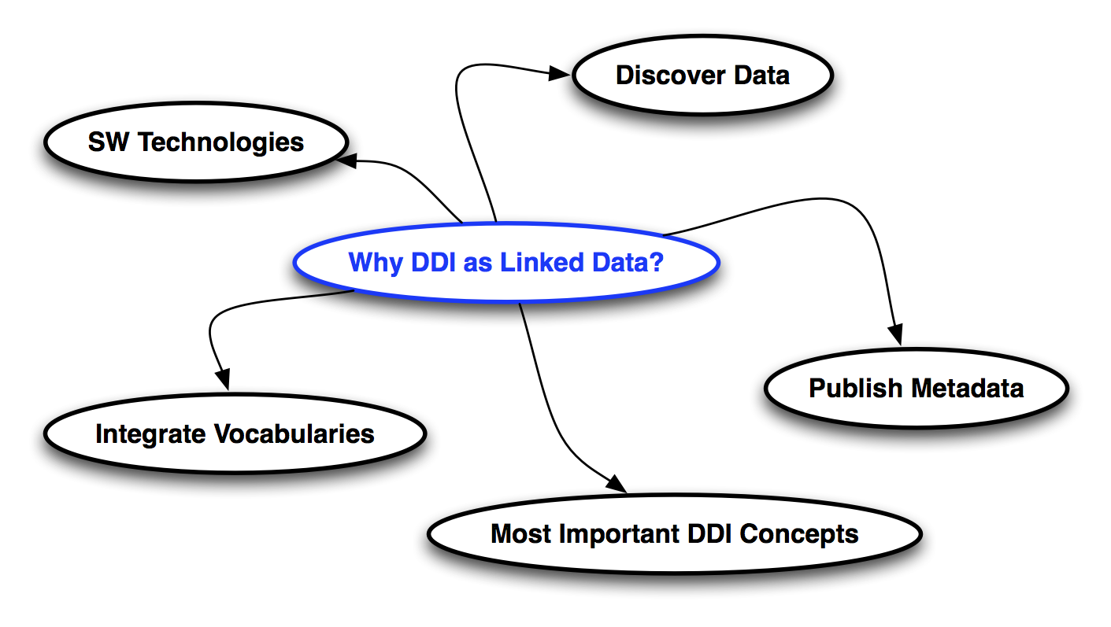
Why DDI as Linked Data?

Slide 8

Overview

Slide 9
Where to search for data?

Slide 10
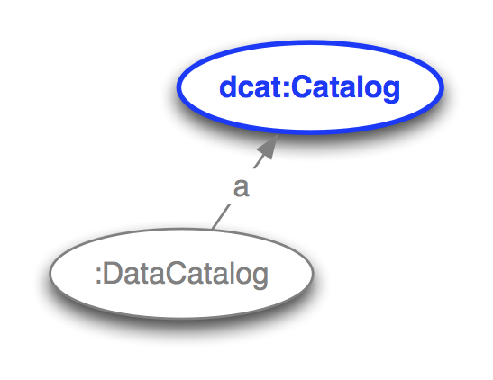
Notes:
Search for data in data collections / data catalogs

Slide 11
Which microdata does exist according to specific metadata?

Slide 12
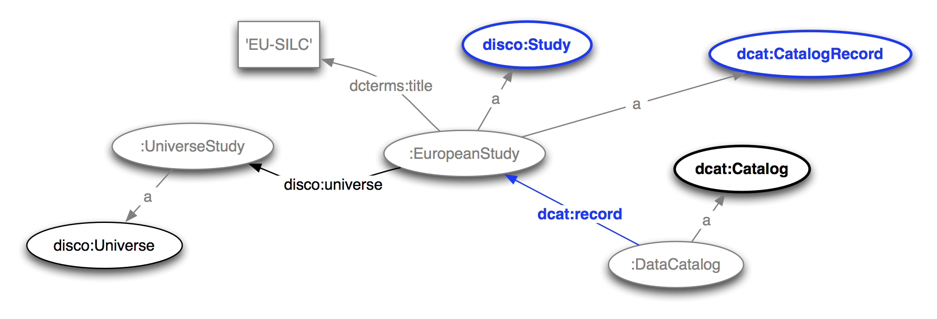

Slide 13
Which datasets are associated with the microdata?

Slide 14
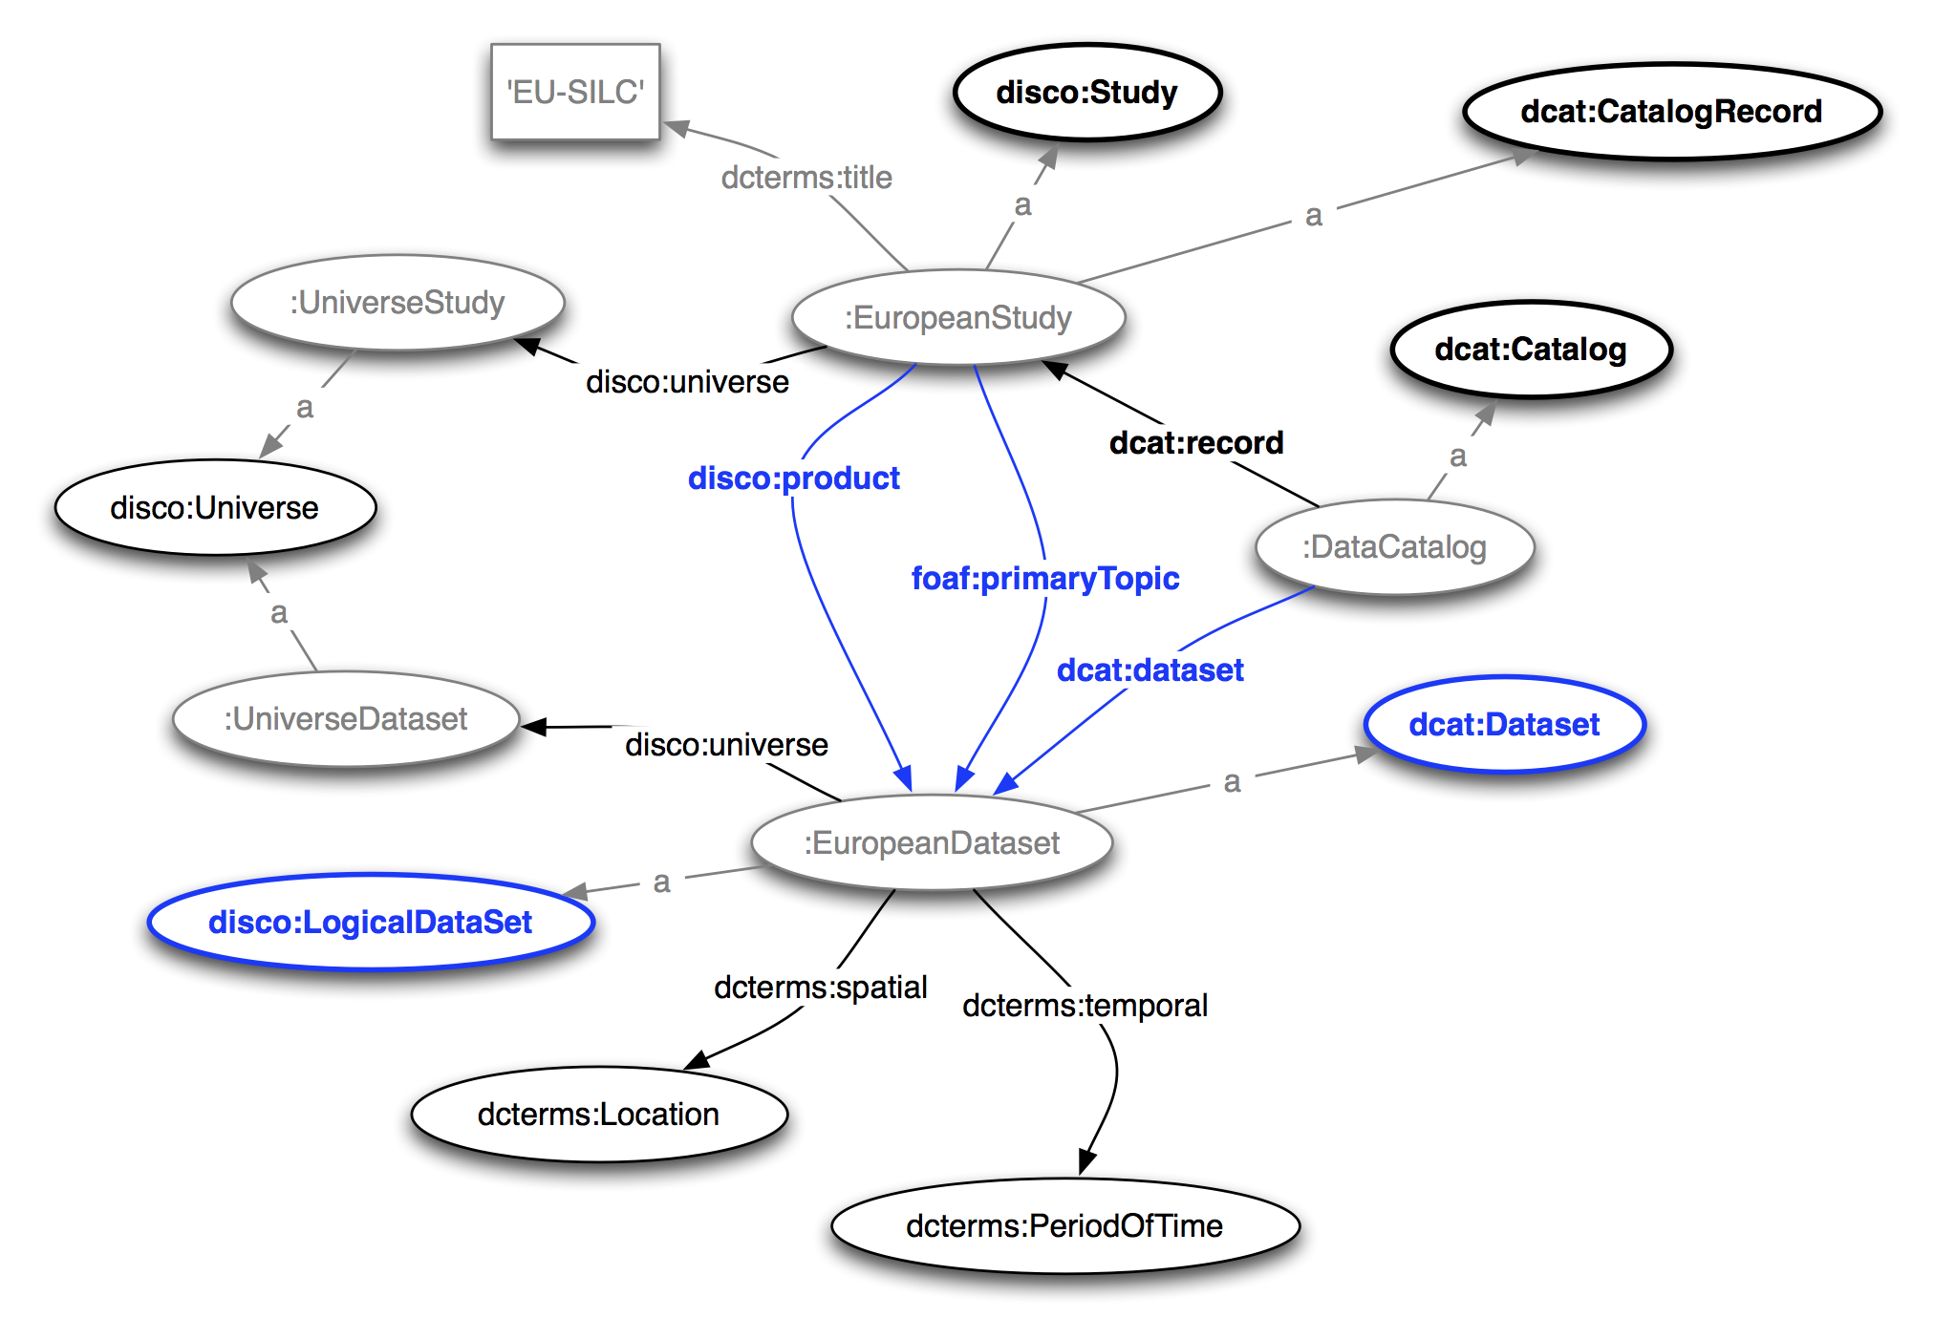

Slide 15
Which aggregated data according to specific metadata does exist?

Slide 16
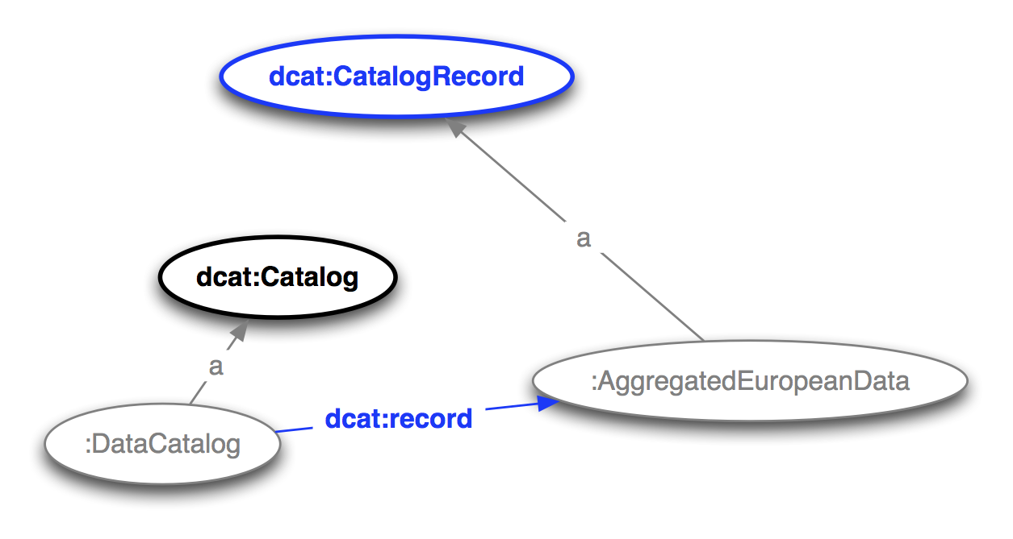

Slide 17
Which datasets are associated with aggregated data?

Slide 18
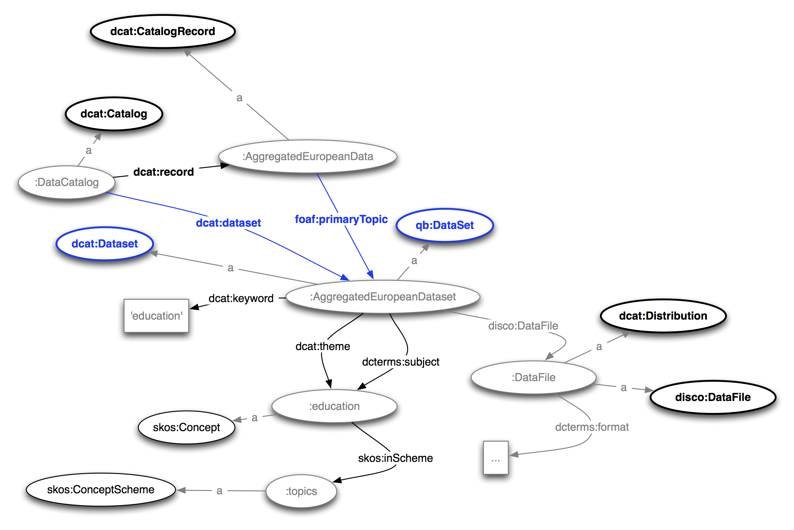

Slide 19
From which microdata datasets is the aggregated dataset derived?

Slide 20
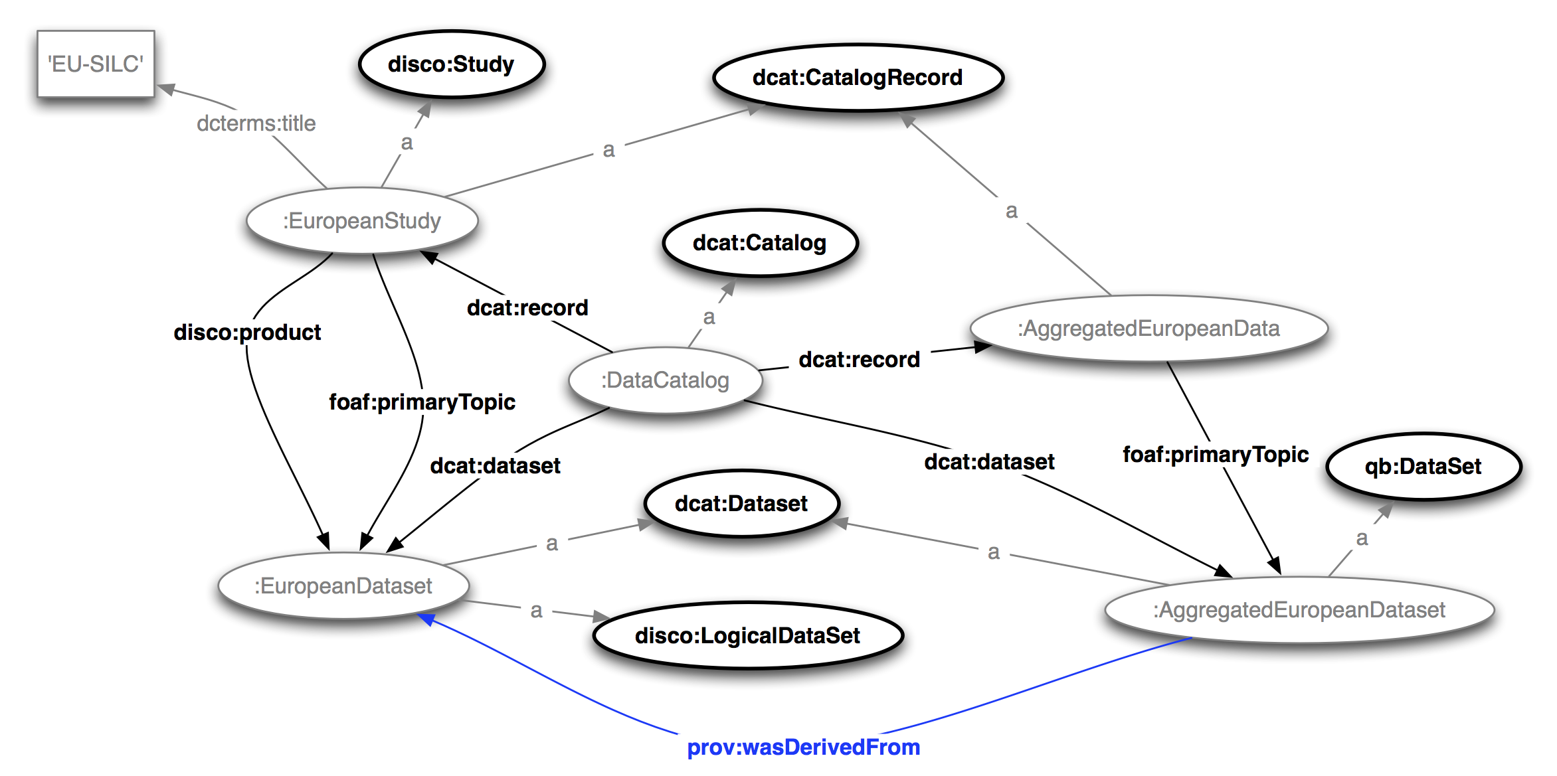

Slide 21
Which summary statistics does a variable have?

Slide 22
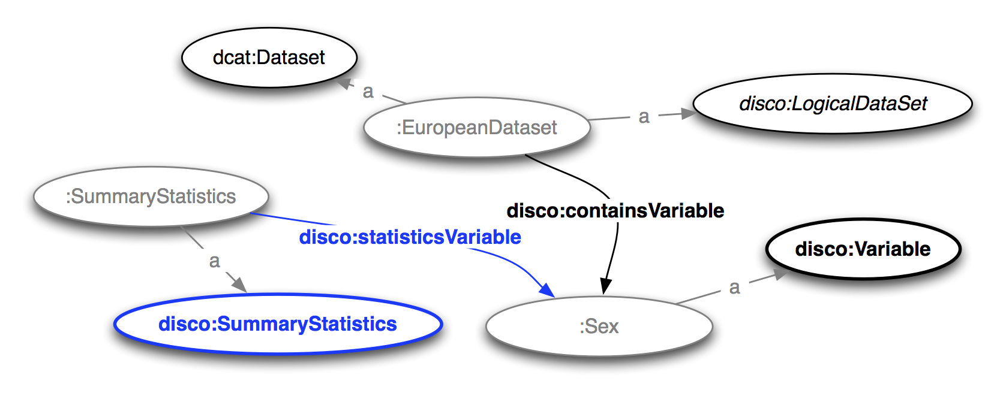

Slide 23
Which category statistics does a variable representation have?

Slide 24
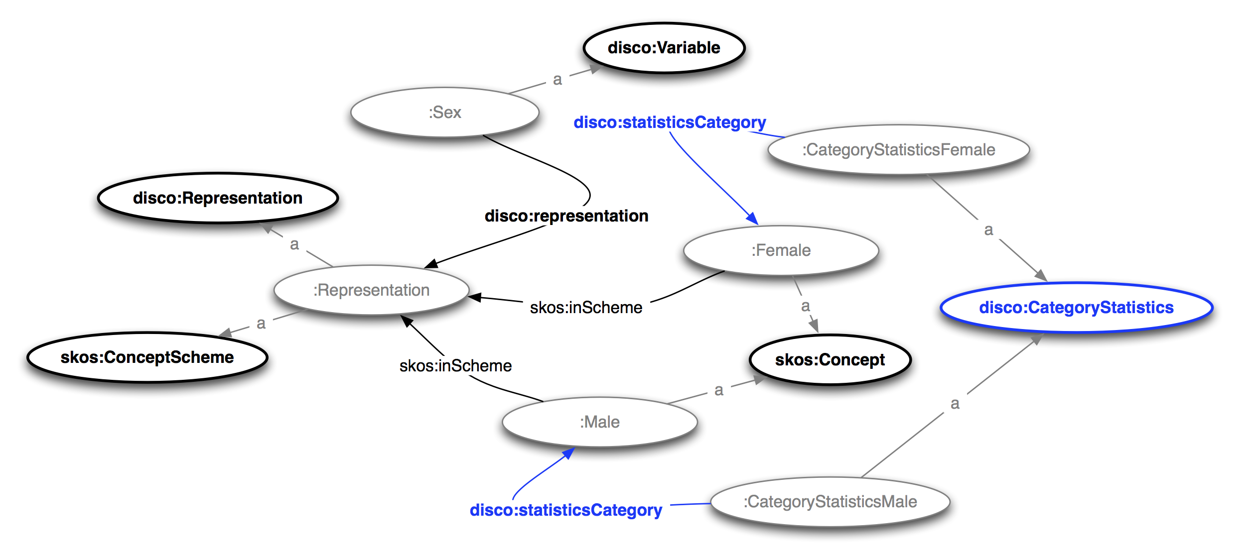

Slide 25
Which microdata datasets are created by the research institute 'GESIS'?

Slide 26
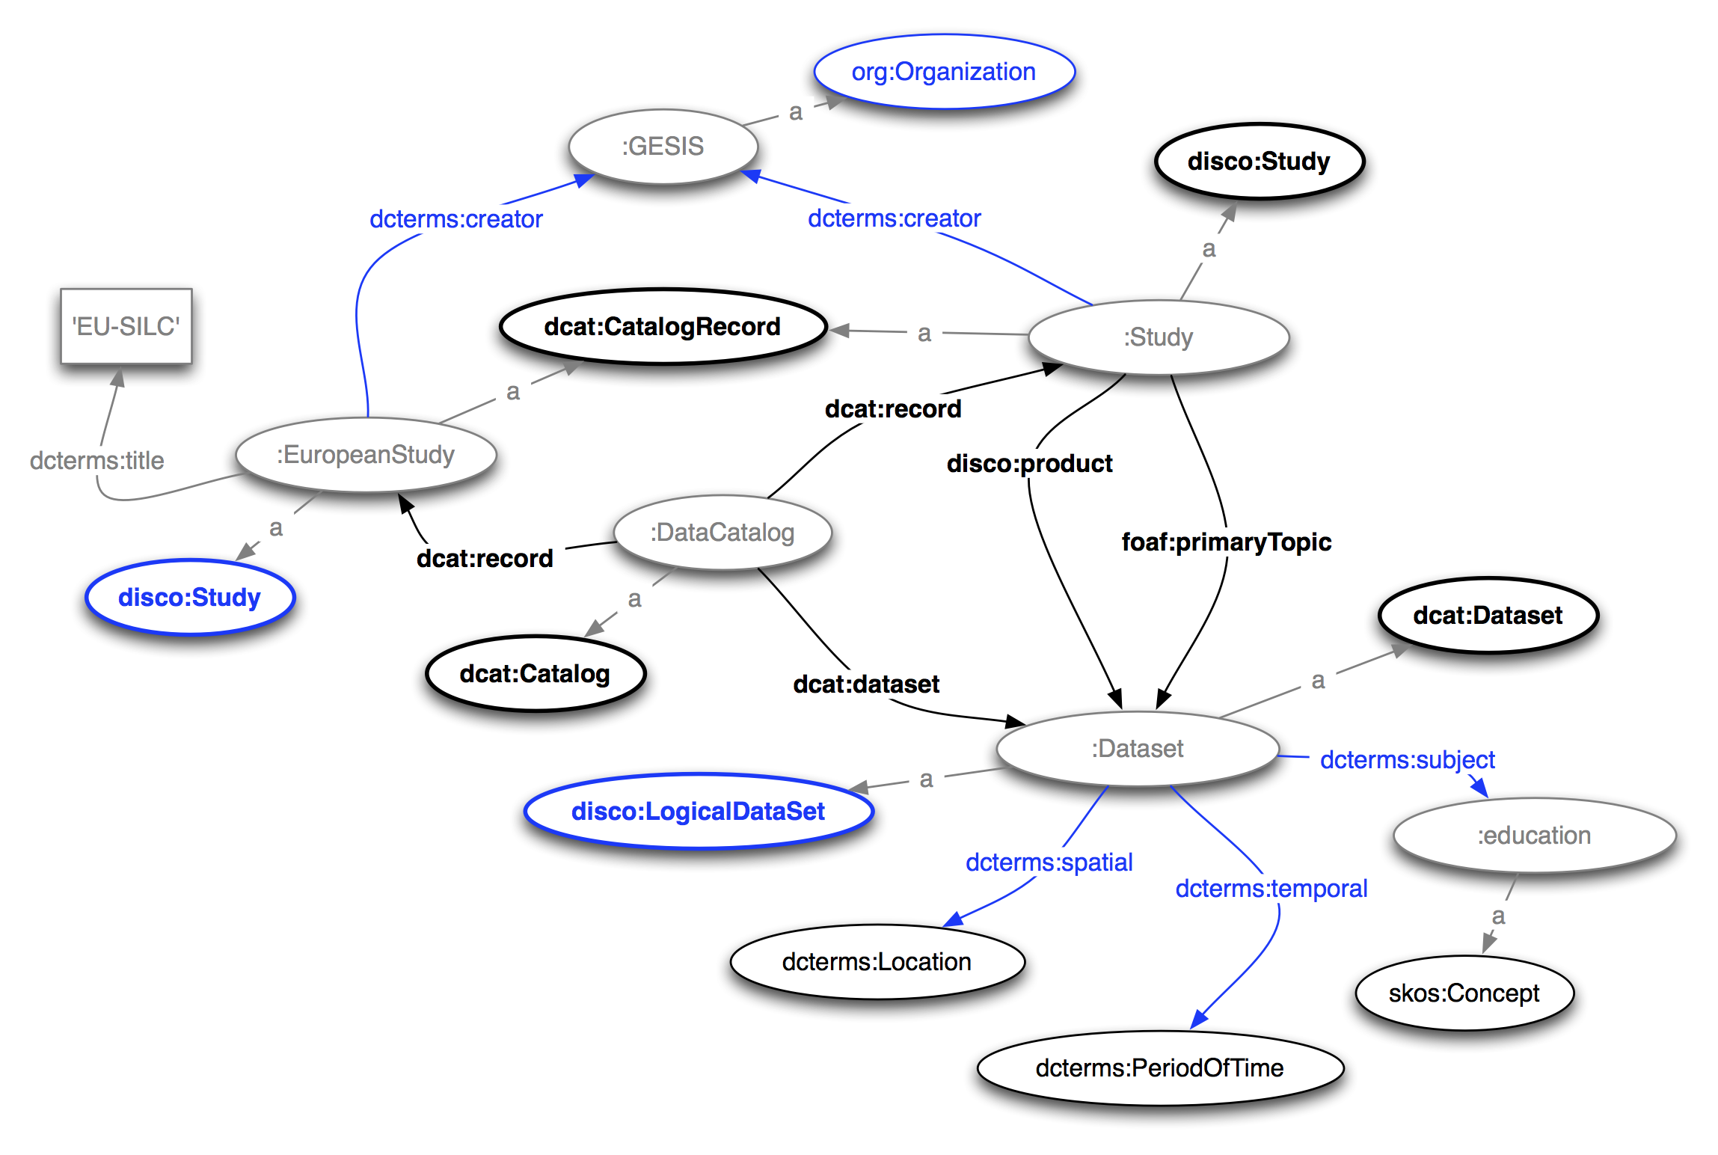

Slide 27
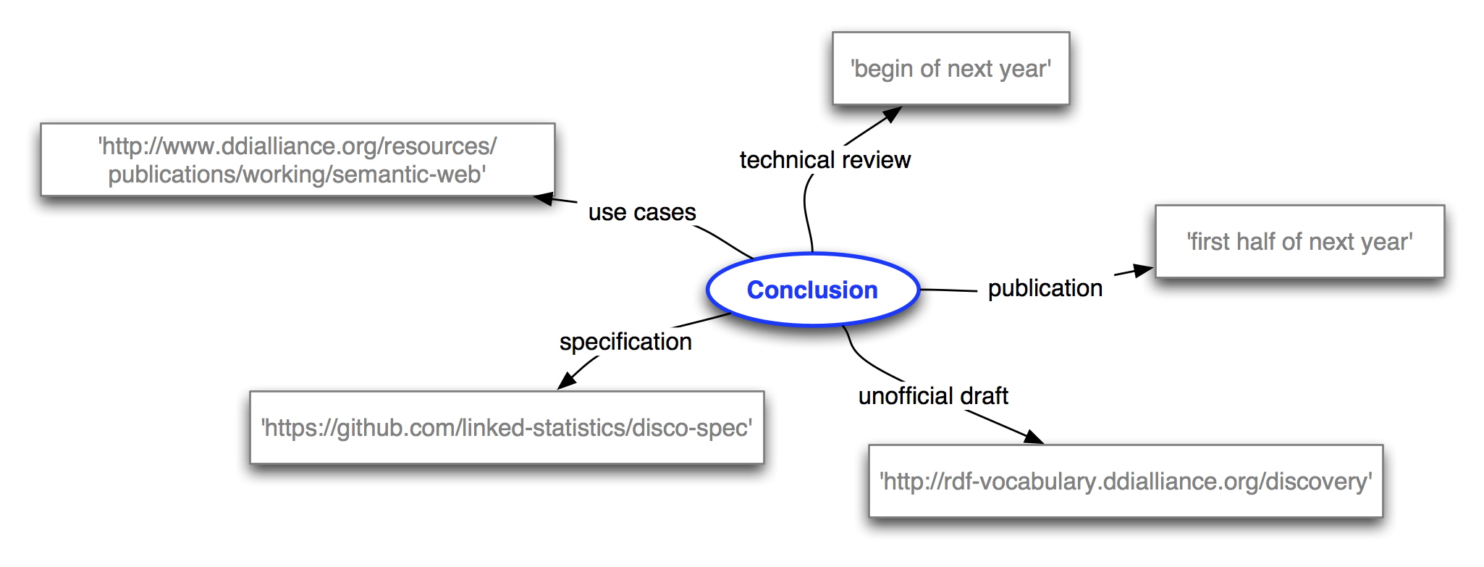
Conclusion

Slide 28
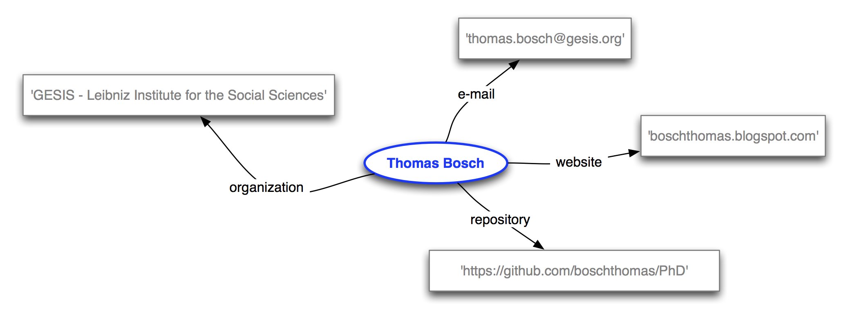
Thank you for your attention…

